Slide 1

FLORIDA HOUSING PROJECT
Kyle Morris
DSC 630
May
2020

Slide 2

INTRODUCTION
On Analysis of the Housing Market in Florida
Where our Data came from
How we validated and cleaned our Data.
How the most important features were selected.
How the model was created.
How the parameters of our model looked.
What challenges arose?
What did our final model look like?
How did the model compare to the actual data?
What can we conclude?

Slide 3

PROBLEM
Given the attributes of a home, can we predict the fair market value of the residence?
The information came from the Census bureau directly.
While data is available for all 50 states, the District of Columbia, and Puerto Rico, this model is focused on the Florida portion.
The 2018 data is utilized. While we can adjust for inflation and incorporate multiple year’s worth of data in the analysis, only the most recent data will be used.

Slide 4

DATA SOURCE
2018 American Community Survey by the US Census Bureau

Slide 5
DATA CLEANING
3 categories of variables were identified for the purposes of missing numbers:
0 As Valid Value
Mean Appropriate
['BDSP', 'HUGCL', 'NPP', 'NR', 'NRC', 'PARTNER', 'PSF', 'R18', 'R60', 'R65', 'SRNT', 'SSMC', 'SVAL’]
-1 was used for missing values since 0 was a valid response.
These columns were categorical variables coded as numbers and so the mean would not make sense.
'FINCP', 'OCPIP', 'SMOCP’]
Since these were actual values (such as monthly rent, average electricity, etc.) and 0 would not be appropriate, the mean was used for these.
By using the mean, we would avoid creating outliers that would impact the analysis.
All Others
0 was an appropriate value for missing values and so it was used.

Slide 6
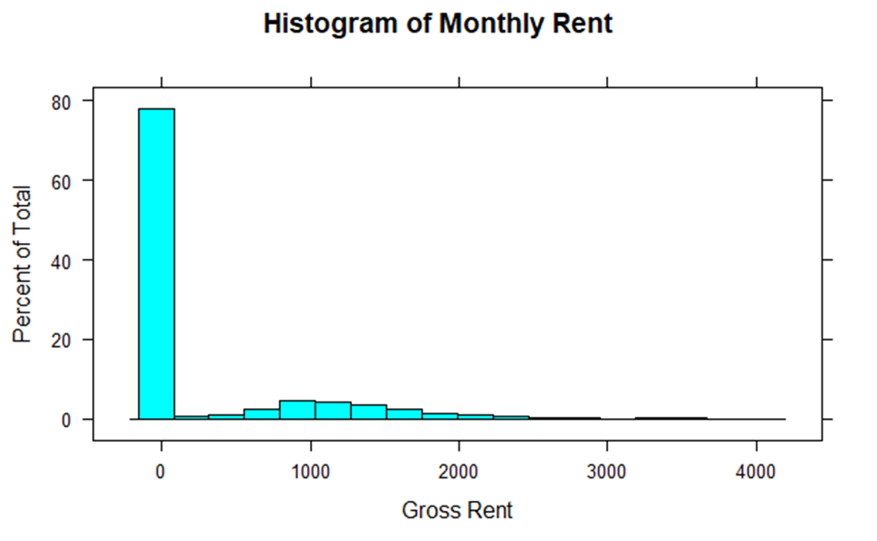
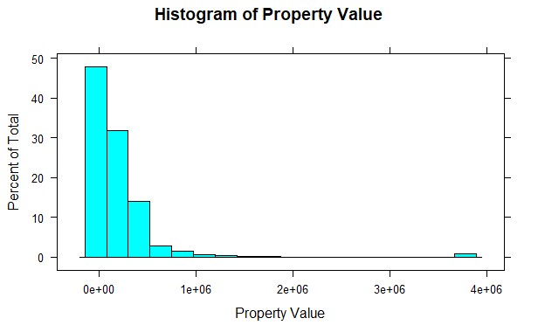
INITIAL GRAPHS
Gross Rent had a large spike at 0, while Property Value was positively skewed.

Slide 7
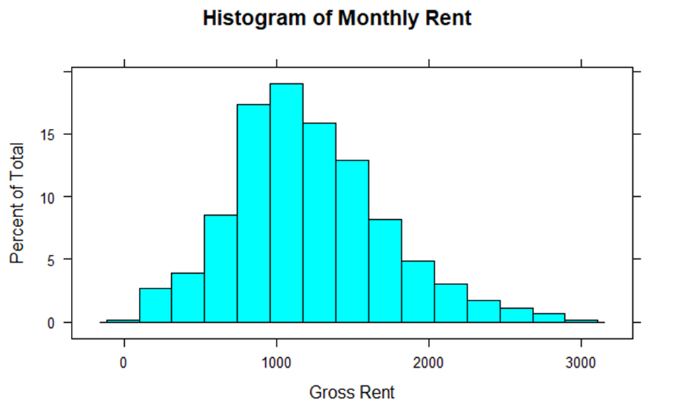
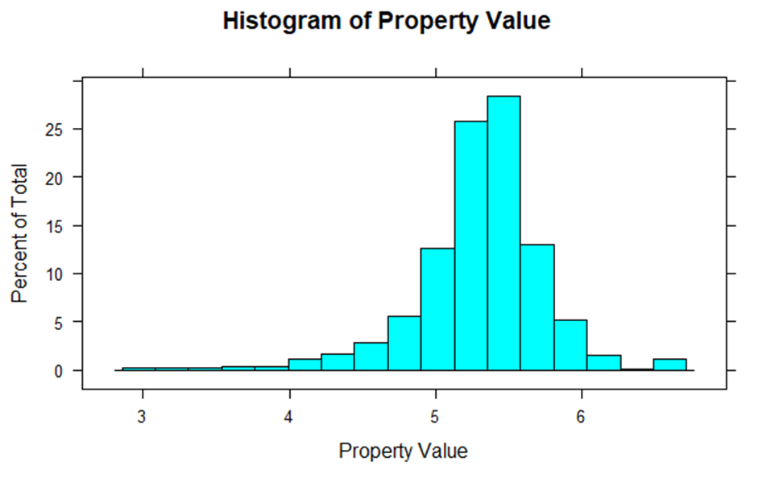
POST CLEANUP
After the changes, the data was much more normally distributed.

Slide 8
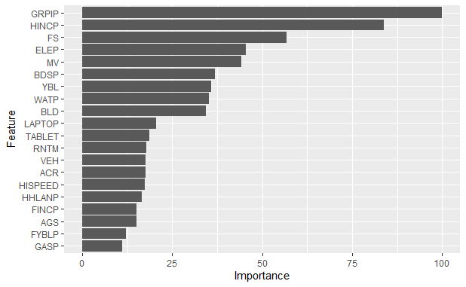
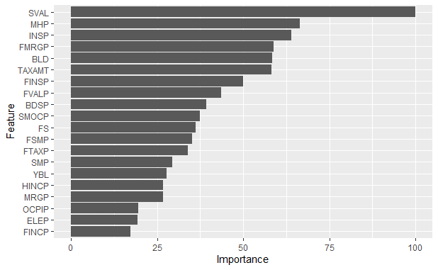
FEATURE SELECTION
Monthly Rent
Varimp was used to classify the important features.
Only the ones most important to determining the value will be used in the model.
Property Value

Slide 9
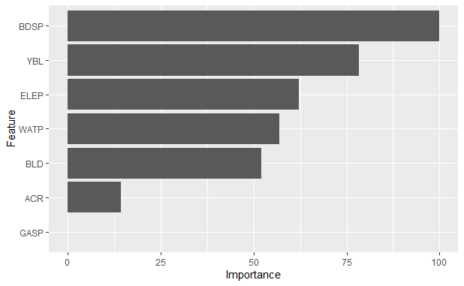
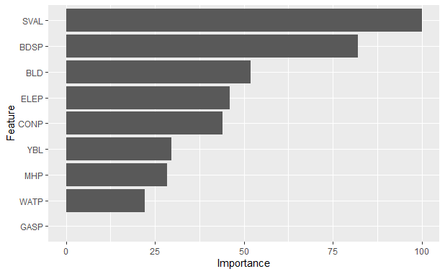
FEATURE SELECTION FIXED
Monthly Rent
Some variables had no effect or were the dependent variable under a different format.
These are the previous charts, but only showing the columns deemed most important.
Property Value

Slide 10
MODEL CREATION
Two models were created, one for predicting Monthly Rent, the other for predicting Property Value.
Linear Regression was used for both models.
Linear Regression is useful due to its linearity and the results are easy to interpret – each coefficient represents the weight that that column has on the final results.

Slide 11
MODEL COEFFICIENTS
Final coefficient outputs from the model. Each coefficient shows the weight of that column in the final value.
Property Value Model
Intercept | SVAL | BLD | MHP | BDSP | YBL | CONP | ELEP | WATP | GASP
5.30326487 | 0.149084 | 0.102204 | -0.04792 | 0.10835 | 0.042578 | 0.080054 | 0.063853 | 0.036906 | 0.015506
Rent Model
Intercept | BDSP | ELEP | YBL | WATP | BLD | ACR | GASP
1216.251757 | 150.4366 | 92.09602 | 98.6556 | 77.07377 | 125.7296 | 45.76685 | 9.230444

Slide 12
CHALLENGES
What was done to optimize the model?
Missing data and how to handle it was a huge factor, given that the data came from self-submitted surveys.
Some of the data wasn’t normalized, which was a requirement for analysis and so transformation techniques were applied.
Data came in one set, and in order to assess the power of a model we need to be able to compare the predicted output to the actual values, so some records were withheld as a testing set.

Slide 13
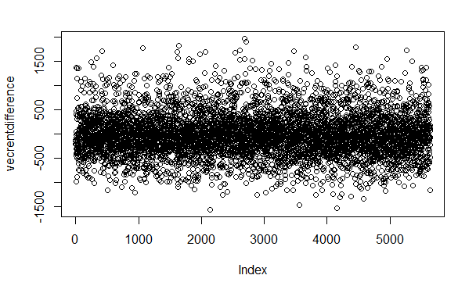
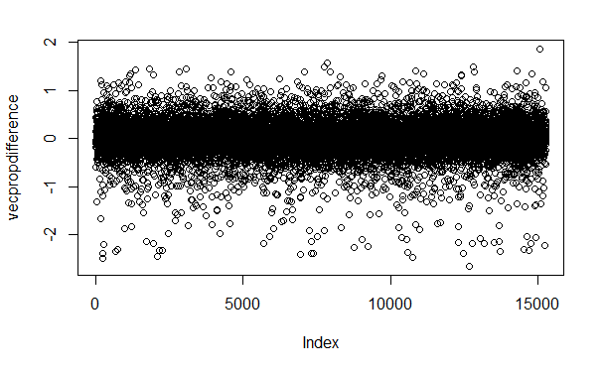
RESULTS
Monthly Rent
These graphs show the spread of the actual costs versus the predicted cost.
The majority of predictions are within ±500 or ±1.
Property Value

Slide 14
CONCLUSIONS
Useful tool to classify a property as overvalued, undervalued, or just right.
The vast majority of predictions fell in line with what we expected.
Data can easily be adapted for other states.
Model can be refined over time – when 2019 data comes out, can easily be run again to adapt to changes in the housing market over time.
Care must be taken not to use the model as gospel.

Slide 15

THANK YOU
Kyle
Morris
Email
kymorris@my365.Bellevue.edu

